Slide 1
Properties of ionic, covalent, and metallic compounds
8 Science

Slide 2
Learning goals
Describe the properties of ionic, covalent and metallic compounds, e.g. melting and boiling point, thermal and electrical conductivity, strength and hardness.
Explain that the type of bonding within ionic, metallic and covalent substances determines their physical properties.
Analyse data to determine the properties, structure and bonding of ionic, covalent and metallic compounds.

Slide 3
We know that…
All atoms react due to their electron arrangement and the stability of the electrons within the valence shell
Ions are atoms or groups of atoms that are electrically charged due to an imbalance in the number of electrons and protons. This is due to atoms being at their most stable when they have full electron shells.
In order to fill shells, atoms can lose electrons, gain electrons or share electrons with other atoms (aka bond).
Ions can be positively charged (more protons than electrons) or negatively charged (more electrons than protons)
The number of electrons lost or gained is determined by the electron configuration of the atom

Slide 4
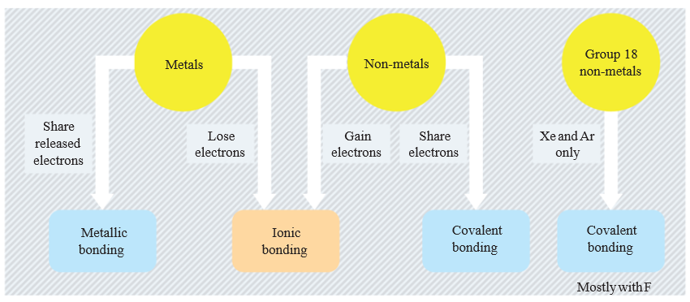
Forming bonds
Atoms bond to exchange electrons to fill their valence electron shells, according to the octet rule (s²p⁶). Different types include:

Slide 5
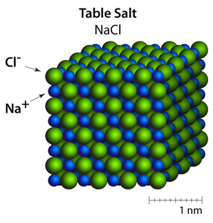
Ionic compounds

Slide 6
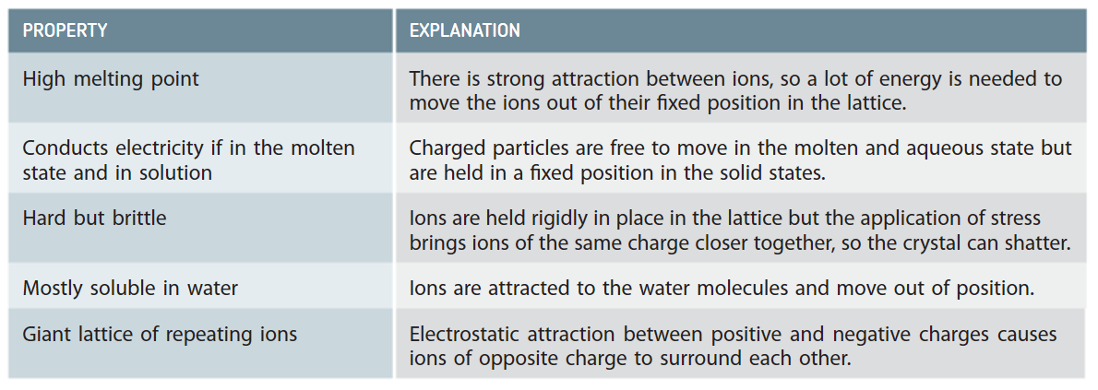
Properties of ionic compounds

Slide 7
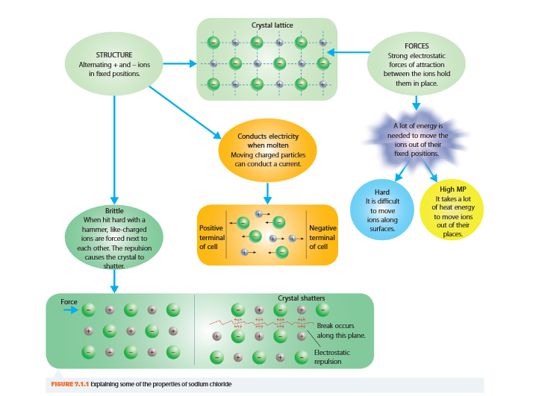
structure
Ionic substances form non-directional bonds. This repeating pattern forms crystalline lattices, due to the electrostatic forces that hold their structure together.

Slide 8
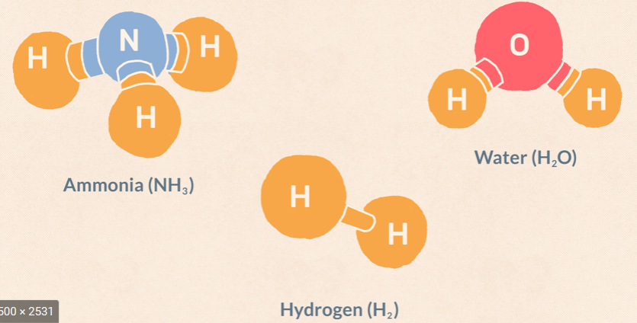

Covalent compounds

Slide 9
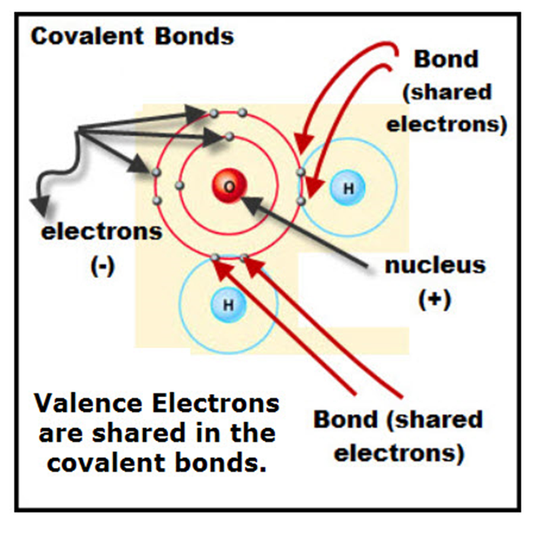
Forming bonds - covalent
Between non-metals and non-metals
Sharing of electrons that move around both nuclei
Forms between non-metallic atoms with similar electronegativities
Gives specific molecular shapes
Each pair of electrons shared is a single covalent bond
Double and triple bonds are also seen to fill electron shells

Slide 10
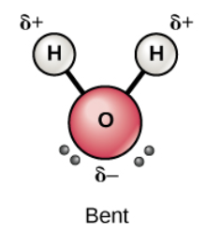
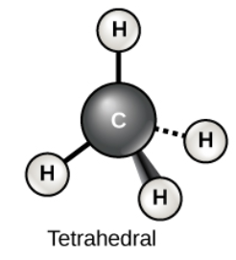
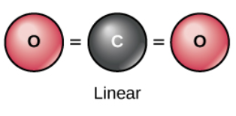
Properties of Covalent Substances
Sharing electron pairs creates strong bonding forces within molecule, giving a definite molecule shape
Often gases or liquids (weak intermolecular forces)
Solids have low melting and boiling points (below 300ºC)
High to low solubility in water
Poor to non-conducting aqueous solutions
Notes:
We need to make sure we’re precise with our terminology when discussing bonding – intra means within, inter means between!

Slide 11
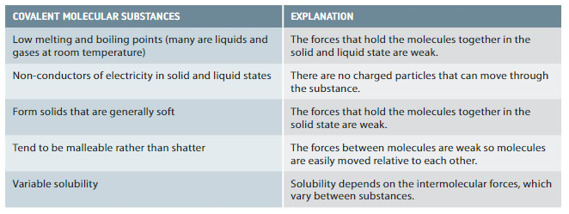
Properties of covalent substances

Slide 12
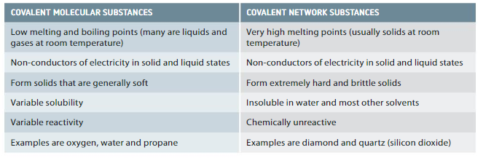
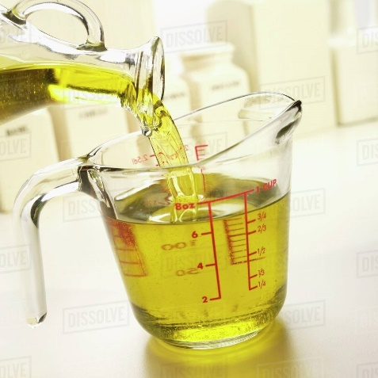
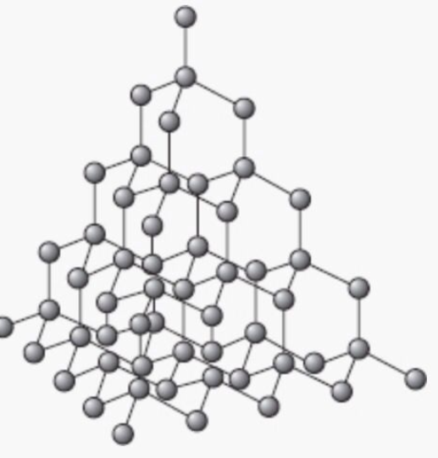
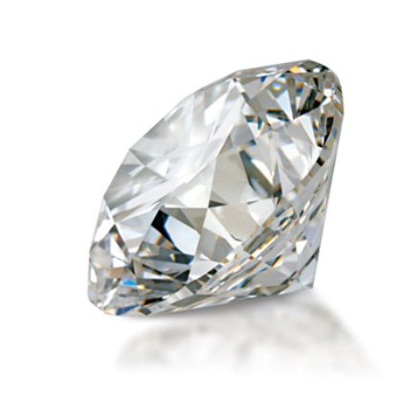
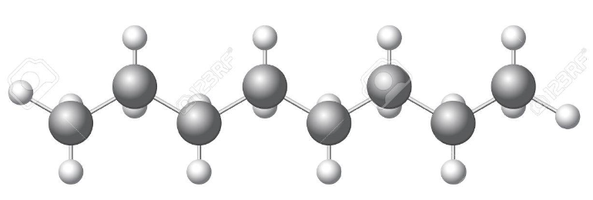
Notes:
When we talk about properties of covalent substances, we’re going to be discussing covalent molecular substances 98% of the time.

Slide 13
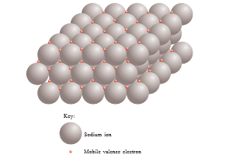
Forming bonds - metallic
Metal atoms lose electrons to form positive ions (cations)
When surrounded by other metal ions, valence electrons are loosely held between atoms (delocalised electrons)
These delocalised electrons can move randomly between atoms, like a ‘sea of electrons’
The electrostatic force of attraction between the negatively charged electron and positively charged metal ion holds the structure together, making metallic bonds
This enables most metals to exist in elemental form

Slide 14
Formula of Metallic compounds
This is super simple
We just use the atomic symbol
E.g. Copper metal : Cu
Magnesium: Mg

Slide 15
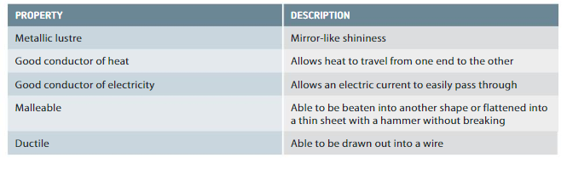
Properties of Metallic Substances

Slide 16
Properties of Substances
Substance | Formula | Melting Point (ºC) | Boiling Point (ºC) | Conductivity
 |  |  |  | In solids | In liquids
Ammonia | NH₃ | -77 | -33 | No | No
Copper | Cu | 1084 | 2562 | Yes | Yes
Chlorine | Cl₂ | -102 | -34 | No | No
Copper (II) Chloride | CuCl₂ | 498 | 993 | No | Yes
Nitrous Oxide | N₂O | -90 | -88 | No | No
Sodium Chloride | NaCl | 801 | 1413 | No | Yes
Oxygen | O₂ | -219 | -183 | No | No
Water | H₂O | 0 | 100 | No | No
Identify the substances that are ionic, covalent and metallic.
Draw a conclusion about the structure and bonding of these substances, by evaluating their properties.

